Slide 1
Infrastructure as Code

Slide 2
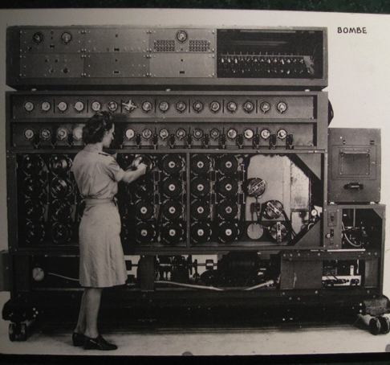
Infrastructure as Code
Programmatically provision and configure components
Treat like any other code base
Reconstruct business from code repository, data backup, and compute resources

Slide 3
Infrastructure as Code
BUILD
DEPLOY
MANAGE
Develop reusable Cookbooks
Expose tunable settings
Test locally to reduce risk, and ensure compliance
Commit to Source Code
Automated Testing through Continuous Integration
Automatically promote across environments
Easily deploy new configurations in a matter of minutes.
Continuously verify and repair misconfigured systems

Slide 4
Test-driven Development
Write a unit test, watch it fail
Write some code
Write and run more unit tests
Run some integration/acceptance tests
Code review
Delivery pipeline to production
Lowered chance of production failure
Add a test
pass
Run the tests
fail
Make a little change
pass
[development continues]
fail
Run the tests
pass
[development stops]

Slide 5
Software Testing and Why it Matters
more time
more time
manual
tests
automated
API tests
automated
GUI tests
automated unit tests
automated
integration tests
integration
tests
less time
less time
automated
GUI tests
unit
tests
manual session based tests
automated
component tests
quantity
quantity
Testing builds safety through feedback loops
Inexpensive experiments to provide validation
Reduces risk
Optimize Testing: Do more of the inexpensive testing first!

Slide 6

Remember
Infrastructure policies need testing
Static Analysis
Unit Testing
Integration Testing
Compliance Testing
Infrastructre as Code should be treated like ANY other codebase.

Slide 7
Integration Testing – Add tests
describe package 'httpd' do
it { should be_installed }
end
describe service 'httpd' do
it { should be_running }
it { should be_enabled }
end
describe port(80) do
it { should be_listening }
end
Add a test

Slide 8
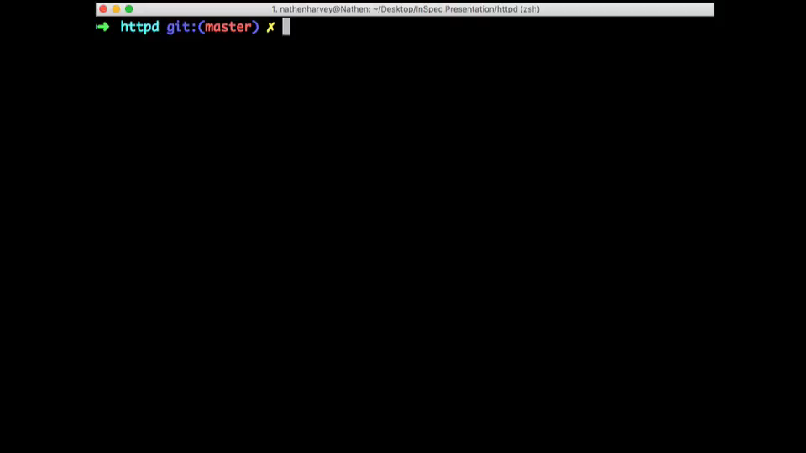
Integration Testing – Run the tests
Add a test
pass
Run the tests

Slide 9
Integration Testing – Make a change
package 'httpd' do
action :install
end
service 'httpd' do
action [ :start, :enable ]
end
Add a test
pass
Run the tests
fail
Make a little change

Slide 10
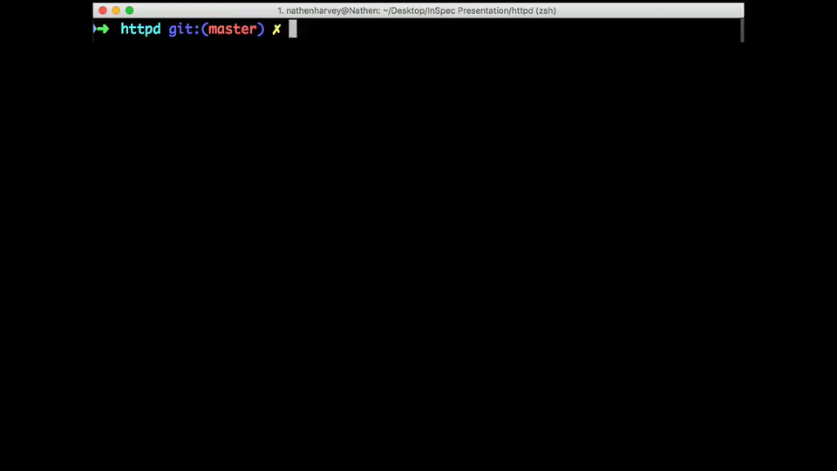
Integration Testing – Apply the change
Add a test
pass
Run the tests
fail
Make a little change

Slide 11
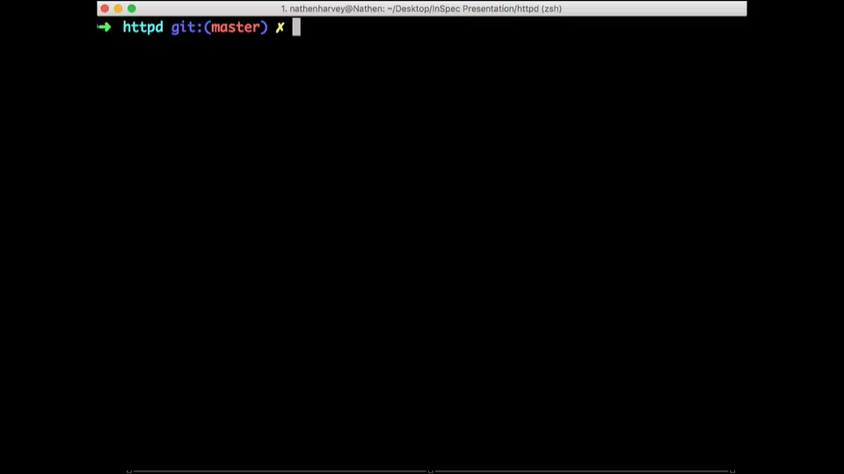
Integration Testing – Run the tests
Add a test
pass
Run the tests
fail
Make a little change
pass
[development continues]
fail
Run the tests
pass
[development stops]

